Slide 1
EasySearch
Semantic Aware Search for Local Machine

Slide 2
PROBLEM STATEMENT
To develop a tool for the research community which can be used to search for searching in the desired documents in an efficient and accurate manner.
Research work requires the reading of a lot of papers, surveys and journals. Every time he/she needs to find such articles, the researcher needs to explore the internet and download them. It is commonplace for such scholarly articles to not have any proper titles. Most file search engines available in the operating systems are not capable of searching within documents and even if they do, they are just performing exact string matching which is a far cry from the efficient and accurate semantic search implemented by online search engines like Google.
When the researcher needs these documents again, he/she would either have to open each document and check manually, or find them again on the internet. This results in not only a waste of effort but also a huge mess in the downloads folder. Hence, the need of the hour is to have a search engine to search semantically within documents in the local file system.

Slide 3
OVERVIEW
With present day large pool of information and the rapidly increasing storage capacity on a computer, it is impossible for human beings to search through all the data available manually. Searching for data on the Internet is easier as compared to searching on one’s desktop because of the quantity of files and state-of-art search engines. To reach the right document concerning a specific topic is a task in itself. Especially for researchers, searching for a specific topic among the huge set of research papers seems impossible given the different domains and fields.
The current Desktop Search Engines like Docfetcher, Beagle++, Locate32, Recoll, Spotlight, etc. are mostly used for searching among different file types and to perform linguistic search on text documents. As opposed to these tools, we aim at making semantic search as one of the most important features of this project.

Slide 4
HIGHLIGHTS
USES:
This project is being designed by keeping in mind the needs of a research scientist and would be highly beneficial to them.
It would cater to their requirement of searching from a vast variety of documents (viz. research papers) on their Desktop.
As opposed to search on the web which would display infinite search results, user would be able to search among the documents he wishes to.
NOVELTY:
We have done a thorough search of the tools available for search on a user’s Local Drive. Despite the presence of many state-of-the-art tools, none of them is proficient in semantic search. Thus this project would be a first of its kind.
A crucial step in the workflow was keyword extraction, for which after studying various techniques and algorithms we came across sCAKE which claims to be better than the rest. We are proposing an extension to the algorithm hence maintaining the originality of the project.
The main focus of our project is to extract efficient KEYPHRASES (bigrams/trigrams) from a given set of documents adhered to multiple constraints like word length, etc.

Slide 5
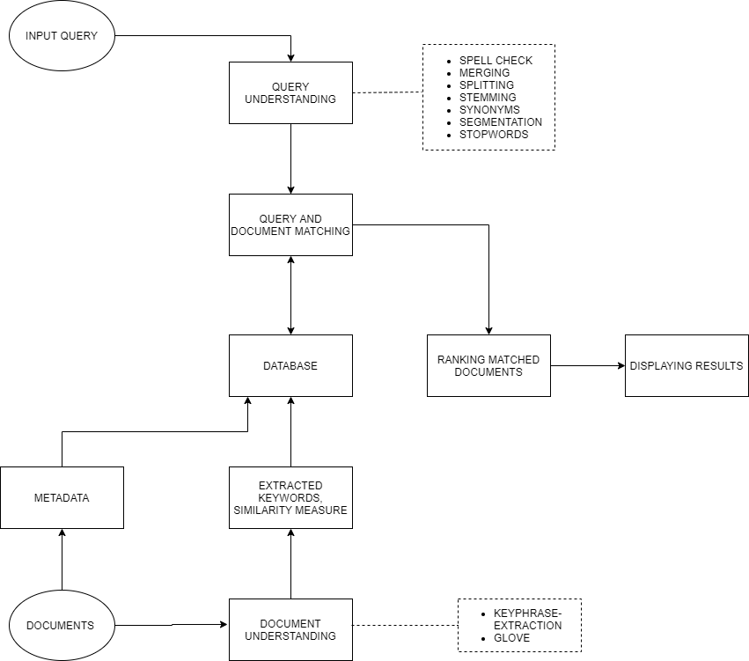
FLOW DIAGRAM
This represents the four major phases of the project, namely:
Document Understanding
Database Creation
Query Understanding
Matching & Ranking

Slide 6
IMPLEMENTATION DETAILS
Document Understanding:
To build the database of words and rank them within a document, we needed to find out the appropriate way to rank the words and select candidate keywords/keyphrases.
All the documents among the given dataset are assessed to find out relevant keywords and key-phrases that would be later used to feed into the database.
This phase of the project required us to choose between a variety of keyword extraction algorithms. We extensively researched well known algorithms like RAKE, k-core, Position Rank etc. and found out that sCAKE which is a newly proposed technique [2018] works best for keyword extraction.
We have modified the sCAKE algorithm by introducing various changes like adding word length constraint where keywords of less than length three are discarded. Also the existing sCAKE model uses POS-tagging due to which many verbs are weeded out. The proposed model is a parameterless, POS-tagging free and it is capable of identifying and replacing abbreviations. One key feature is identifying bigrams and trigrams which act as keyphrases.

Slide 7
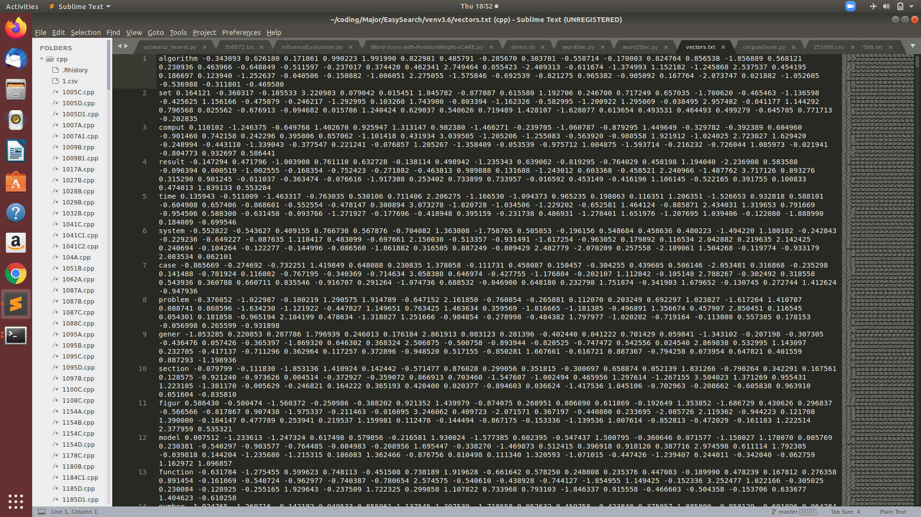
Once the keywords and key phrases are found, the similarity between two terms is found using word embeddings via GLOVE.
Word embedding is used to model the term-term similarity. Word embedding is the collective name for a set of language modeling and feature learning techniques in natural language processing where words or phrases from the vocabulary are mapped to vectors of real numbers.
Latest technologies like Glove, Elmo and Bert have been studied and we have identified the advantages and gaps for all of them and settled on GloVe as it best suited our requirements. The figure above shows 50 dimensional embeddings of few words.

Slide 8
sCAKE
We have used sCAKE (Semantically Aware Keyword Extraction) for keyword extraction which has the best performance among the graph methods. It creates a Context-Aware Graph (CAG) using co-occurrences of the words. The important thing to note here is that it uses a window size of 2 sentences for measuring co-occurrences. It also proposes a new scoring model for scoring the keywords.
We have modified sCAKE and proposed our own keyword extraction model. This is because sCAKE still has a few glitches. sCAKE doesn’t extract key phrases, it extracts keywords only. Another identified gap is that SCScore, the scoring model used in sCAKE uses four features and simply multiplies them to find the score. There is no apparent reason behind doing so. We have assigned appropriate weights to each part of the document depending on its importance for better scoring methodology. Further, we have used an algorithm to identify and replace abbreviations in the document.

Slide 9
…CONTINUED
Database Creation:
The document query matching is done using the database which serves as the base for the Search.
After obtaining the keywords defining a document and the embeddings corresponding to each word. We need to map each word to the documents it occurs in and also relate them in some way.
Two tables are created in the database. First one, wordSim, being the one containing each word, the words closest to it and the inverse of cosine distance between them. This is the same distance that was calculated in the document understanding phase between each word to represent word pair similarity.
The second table, wordDoc contains metadata information of each word. Corresponding to each word, the document it belongs to is stored along with its rank in that particular document. The rank here is a representative of the importance of that word in the document. This rank is calculated in the document understanding phase while extracting keywords and keyphrases. Figure 2 shows the schema of both of the tables.

Slide 10
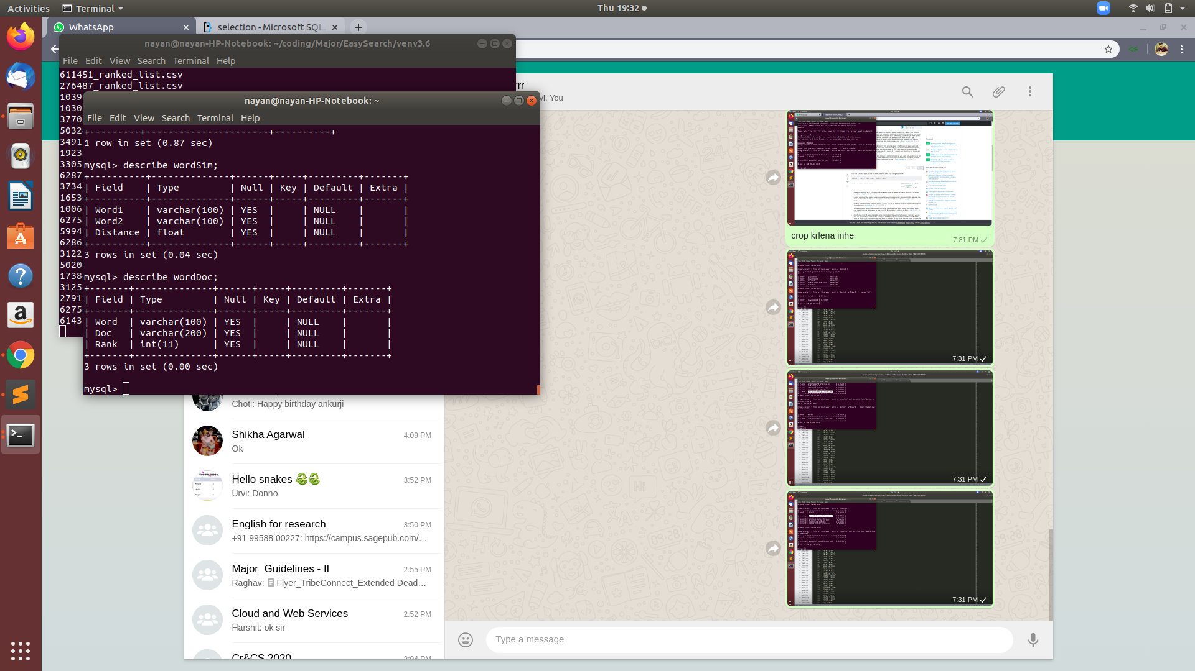
Figure 2.
Schema for tables wordSim and wordDoc

Slide 11
…CONTINUED
Query Understanding:
To match the query a user has searched for, it needs to be pre-processed. This is termed as Query Understanding.
During the process of Document Understanding, a lot of procedures like stemming, stop word removal are performed on the text which modifies the terms to a great extent. For e.g. ‘Machine’ becomes ‘machin’. To match the words Query Refinement needs to be performed which include several procedures, few of which are mentioned below.
Query Refinement techniques include Spell Check, Merging, Stemming, Stop word Removal, Inclusion of Synonyms etc.
After the pre-processing steps, the modified query is looked into the database for finding related words and corresponding documents.

Slide 12
…CONTINUED
Matching and Ranking:
Each word is first matched in table 1 which consists of word pairs and inverse of their cosine difference to locate the searched words neighbours. Once a match is found, the words with closest affinity to the match along with the original word are searched for in table 2. Thus, along with finding exact matches to the word, results will also consist of the closest word those having similar meaning and context to it.
The results to the users are ranked in the following order; first the original word is matched and presented to user with relevant documents, followed by trigrams, bigrams and unigrams and its related documents and then comes pre-processed query results along with its metadata information. N-grams are given highest ranking in the results pool generated in response to user query. The top related words fetched from table 1 are displayed in order of closest to farthest. The semantically similar words fetched from WordSim table are then displayed, followed by Synonyms at the end of the ranking ladder to the user. For the word falling within the same pool, they are put in order according to their rank (of keywords) in their respective documents. The ranking shows the most to least relevant documents to the user.

Slide 13
TECHNIQUES
For Keyword Extraction, we have implemented sCAKE algorithm in Python programming language.
sCAKE has been modified in various sense like addition of bigrams and trigrams, removal of tagging, abbreviation identification, etc.
The key phrases extracted are further used for representation of words in vector form with the help of GloVe.
Once the vectors are obtained, similarity between them is obtained using Cosine distance measure.
Database tables are created using MySQL which contain similar words, inverse of their distances and document metadata and is saved on disk.
A pre-processed query is matched with the database and the resultant words and corresponding documents are shown as the output after being ranked.

Slide 14
RESULTS
We run our code for the Krapivin dataset which contains full ACM papers. The comparison is done with sCAKE algorithm using metrics like recall, precision and f1-score for the keywords/keyphrase extraction process.
After introducing the changes mentioned above in the keyword/keyphrase extraction algorithm, we did a comparison of sCAKE algorithm and our extension to it. This was done using f1-score values. We used ‘k’ words from the extracted keywords to match with golden standard data, ranging ‘k’ from 1 to 50. Upon executing sCAKE and our algorithm, following results were observed. :
We have a better max f1-score value: 45.587 which results at a value of k=4 as compared to that of sCAKE that is 40.33 at a value of k=5 (Fig. 2. and Fig. 3.).
Our results are better than sCAKE for the following ranges of k: 1-50

Slide 15
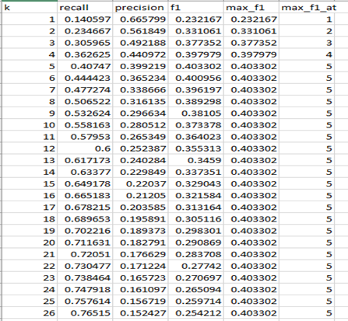
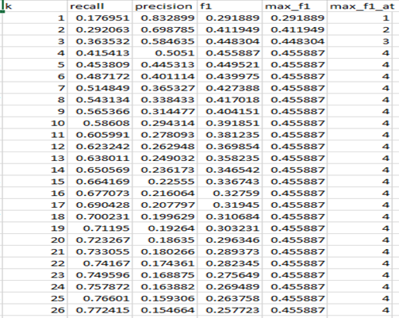
Results
Fig. 2. sCAKE Keyword Extraction Fig.3. EasySearch Keyphrase Extraction

Slide 16
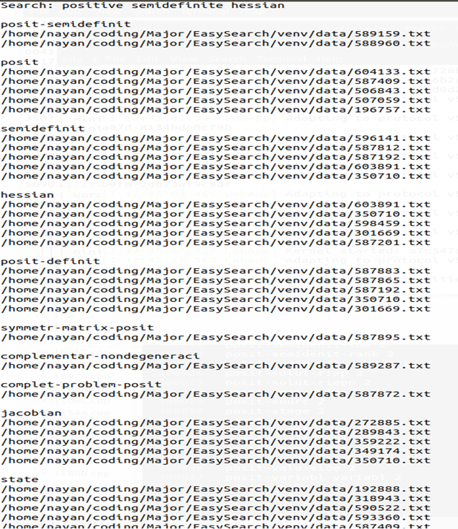
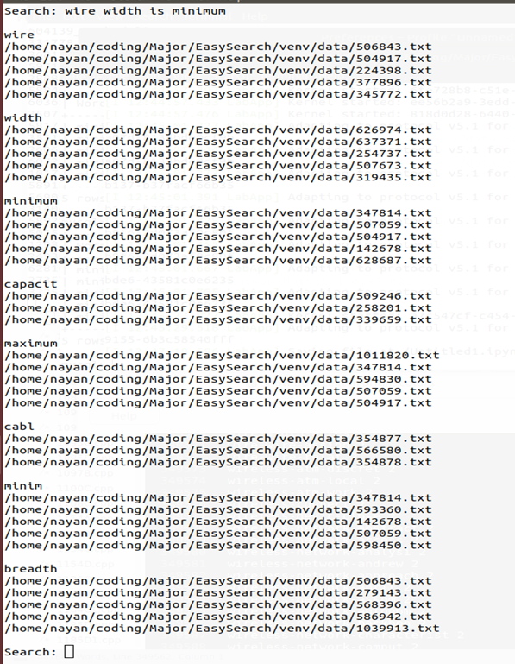
Query Results
Fig. 4. & 5. Query results for phrases ‘positive-semidefinite-hessian’ and ‘wire width is minimum’

Slide 17
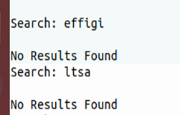
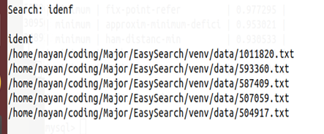
Fig. 5. Result for noisy words Fig. 6. Result for a spell checked word

Slide 18
Conclusion
After extensive survey we came across different techniques for the planned sub-modules for our semantic search engine. The techniques we studied were diverse in nature and offered us with alternate viewpoints to deal with the given problem. For keywords/keyphrase extraction we settled upon graph-based approach of sCAKE as it provided us with best results than its predecessors. We implemented the same by introducing various modifications like addition of bigrams and trigrams, abbreviation resolution, weighted positions, a tagging free approach etc. Once the final model for keyword/keyphrase extraction was completed and it gave satisfactory results, the process of database creation began. As discussed, GloVe was used as the word embedding technique along with a suitable word similarity metric, cosine distance. The database created consists of two tables, one for storing similar words and another for storing metadata. Alongside, several procedures were adapted to refine the query entered by user. This was done to expand the scope of matching more similar words. Once the document understanding, query refining and database creation procedures were over, matching and similar words retrieval was done. Speedy access of results was enabled with the help of a doubly linked list and a dictionary. Finally, the results are ranked and output is displayed.

Slide 19
Future Work
The work done till now consists of keyphrase extraction, vector representation of words and making of database along with metadata storage and matching and ranking a query. Future work will focus on handling the shortcomings of the project. As of now, the model does not read pdf(s) and demands that they be translated to text files in advance. The text file should also contain correct identifiers for title, abstract, body and references otherwise the model does not work as intended. These can be overcome by implementing a pdf reader and identify tags while reading the document. Also, the model fails to remove metadata and words from the table related to a deleted file. This can be covered in future. Further the performance of the keyphrase extraction can be improved by introducing new changes. In addition, other measures may be used to find word similarity apart from Cosine distance, or multiple methods may be assimilated together. Integration of the whole model with the Operation System and development of a suited User Interface are also some of the developments that can be made into the project.

Slide 20
References
1. Duari, S., & Bhatnagar, V. (2019). sCAKE: Semantic Connectivity Aware Keyword Extraction. Information Sciences, 477, 100-117.
2. ZHOU, Q., LE, X. Q., & LI, X. (2013). Applications of JNI Technology in Desktop Search Tool. Computer Technology and Development, 2.
3. Chirita, P. A., Costache, S., Nejdl, W., & Paiu, R. (2006, June). Beagle++: Semantically enhanced searching and ranking on the desktop. In European Semantic Web Conference (pp. 348362). Springer, Berlin, Heidelberg.
4. Pennington, J., Socher, R., & Manning, C. (2014, October). Glove: Global vectors for word representation. In Proceedings of the 2014 conference on empirical methods in natural language processing (EMNLP) (pp. 1532-1543).
5. Schwartz, A. S., & Hearst, M. A. (2002). A simple algorithm for identifying abbreviation definitions in biomedical text. In Biocomputing 2003 (pp. 451-462).
6. Li, H., & Xu, J. (2014). Semantic matching in search. Foundations and Trends® in Information Retrieval, 7(5), 343-469.
7. McKeown, K. R., & Radev, D. R. (2000). Collocations. Handbook of Natural Language Processing. Marcel Dekker, 1-23.

Slide 21
Thank You!
Presented By:
Nayan Garg 16803015
Urvi Agarwal 1603009
Sugandha Singhania 16803007

